Slide 1
Introduction to Functional Programming with JavaScript

Slide 2

Introduction
Farzaneh Orak
Software Engineer
Hunter Industries
Mob programming

Slide 3
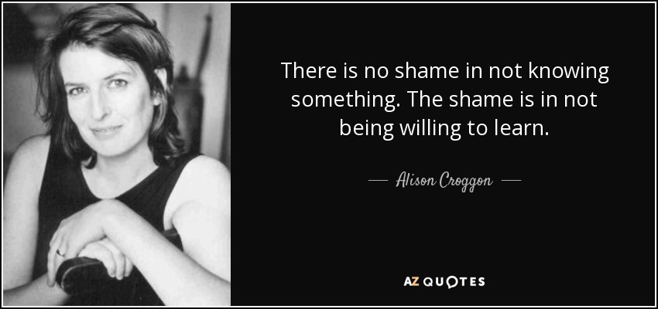
Goal

Slide 4

FP and OOP
Functional Programming
Object-Oriented Programming

Slide 5
JavaScript language
Multi-paradigm
First class function

Slide 6
Which one is better?
Depend on what are you trying to do
Michael Fogus author of “Functional Javascript”
Deal with data about people -> FP
Simulate people -> Object-Oriented Programming

Slide 7

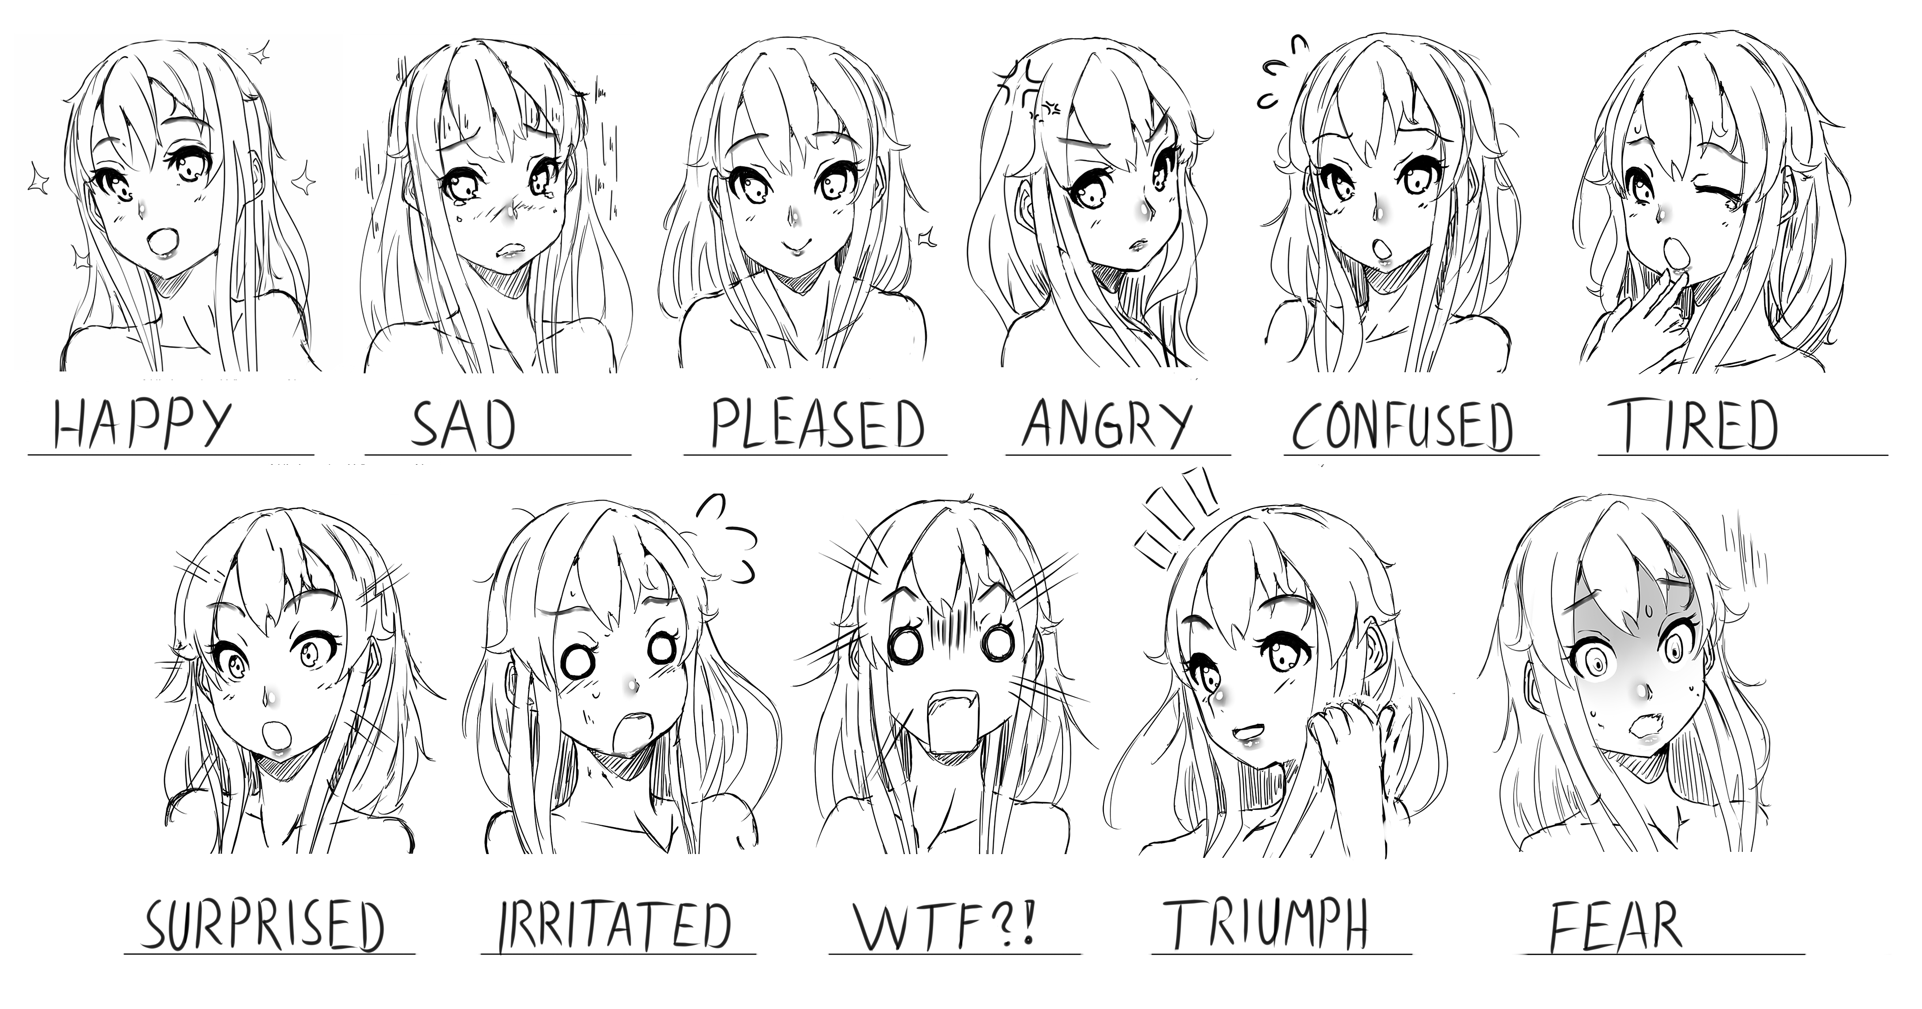
When we use functional
People simulation
Shared state
Data about people
Avoid shared state

Slide 8
What is Functional programming?
Programming paradigm
Style-organizing coding
Way of thinking
Express everything in term of functions
Declarative

Slide 9
Why functional programming?
Increase readability and maintainability
Function reusability
Easier testing and debug
Needs low brain power to read the code

Slide 10
Why functional programming?
Elegant code
Predictability
Less complex

Slide 11
Functional Programming principles
Avoid sharing state
Avoid side effect
Avoid data mutation

Slide 12
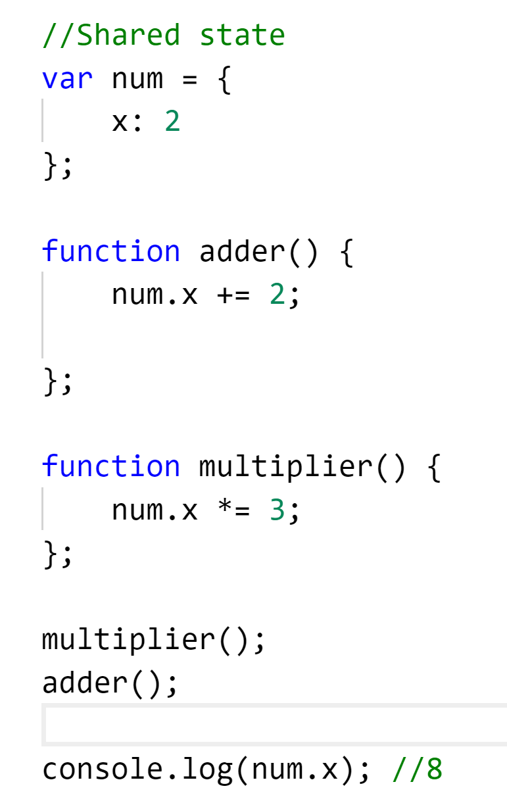
Avoid sharing state

Slide 13
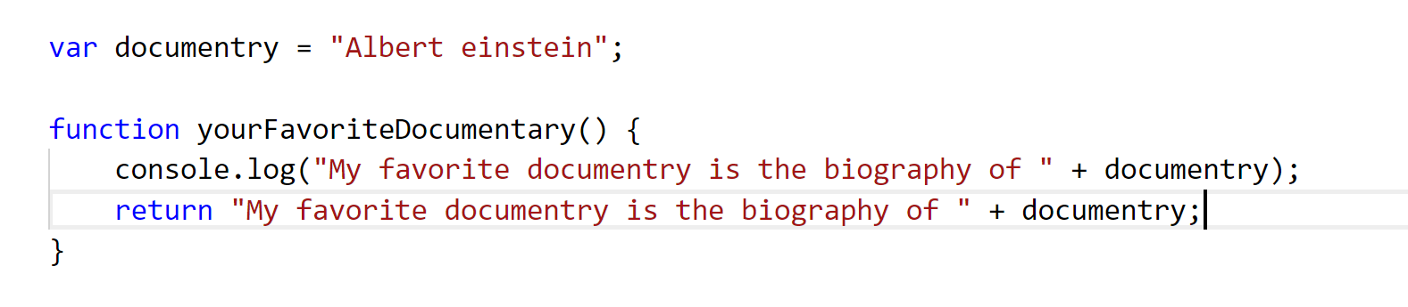
Avoid side effect
Console log
Writing to a file

Slide 14
Avoid data mutation
Once object created it can’t be changed

Slide 15
Functional Programming Techniques
Pure function
Higher order function

Slide 16
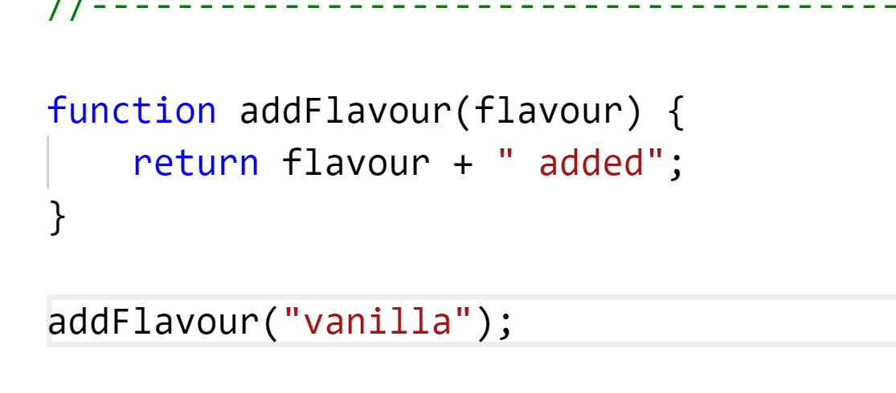
Functional Programming principles
Pure functions
Given the same input, It always returns the same output

Slide 17
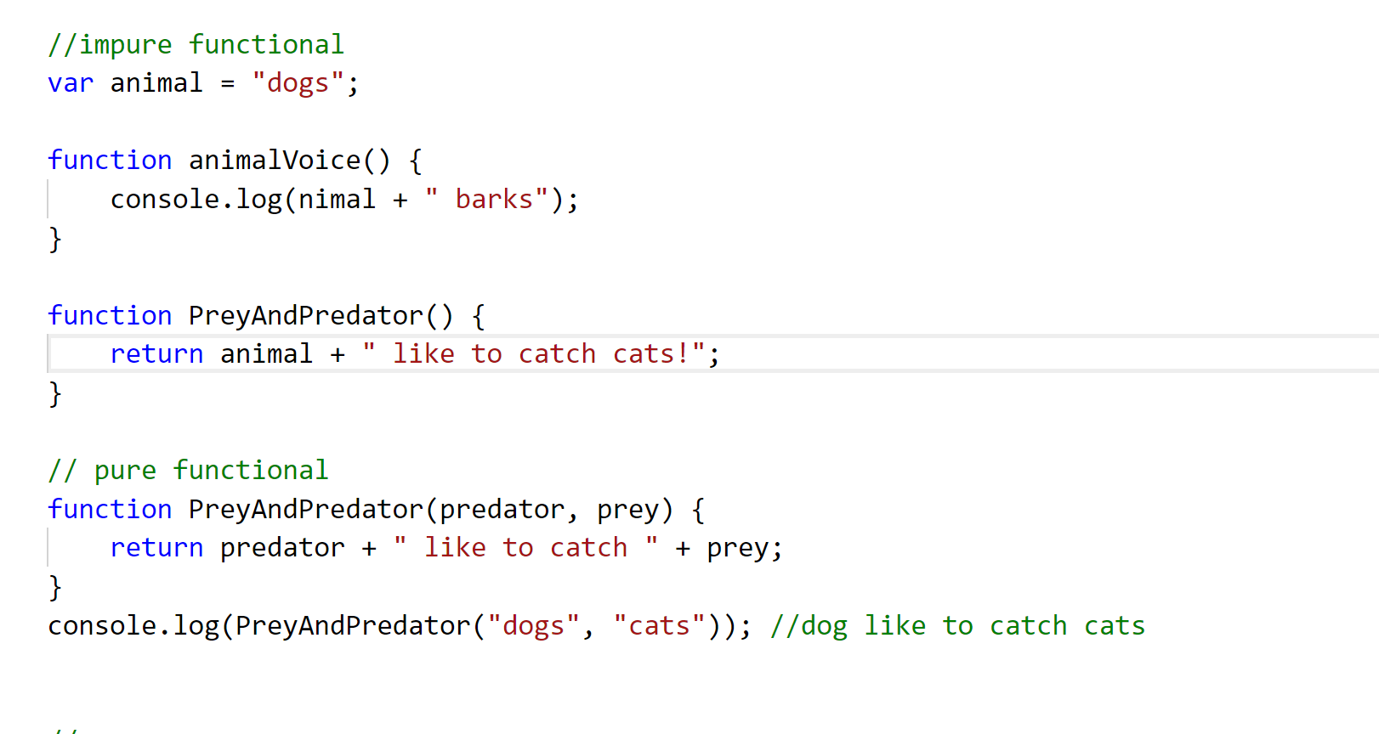
Impure vs Pure functions

Slide 18
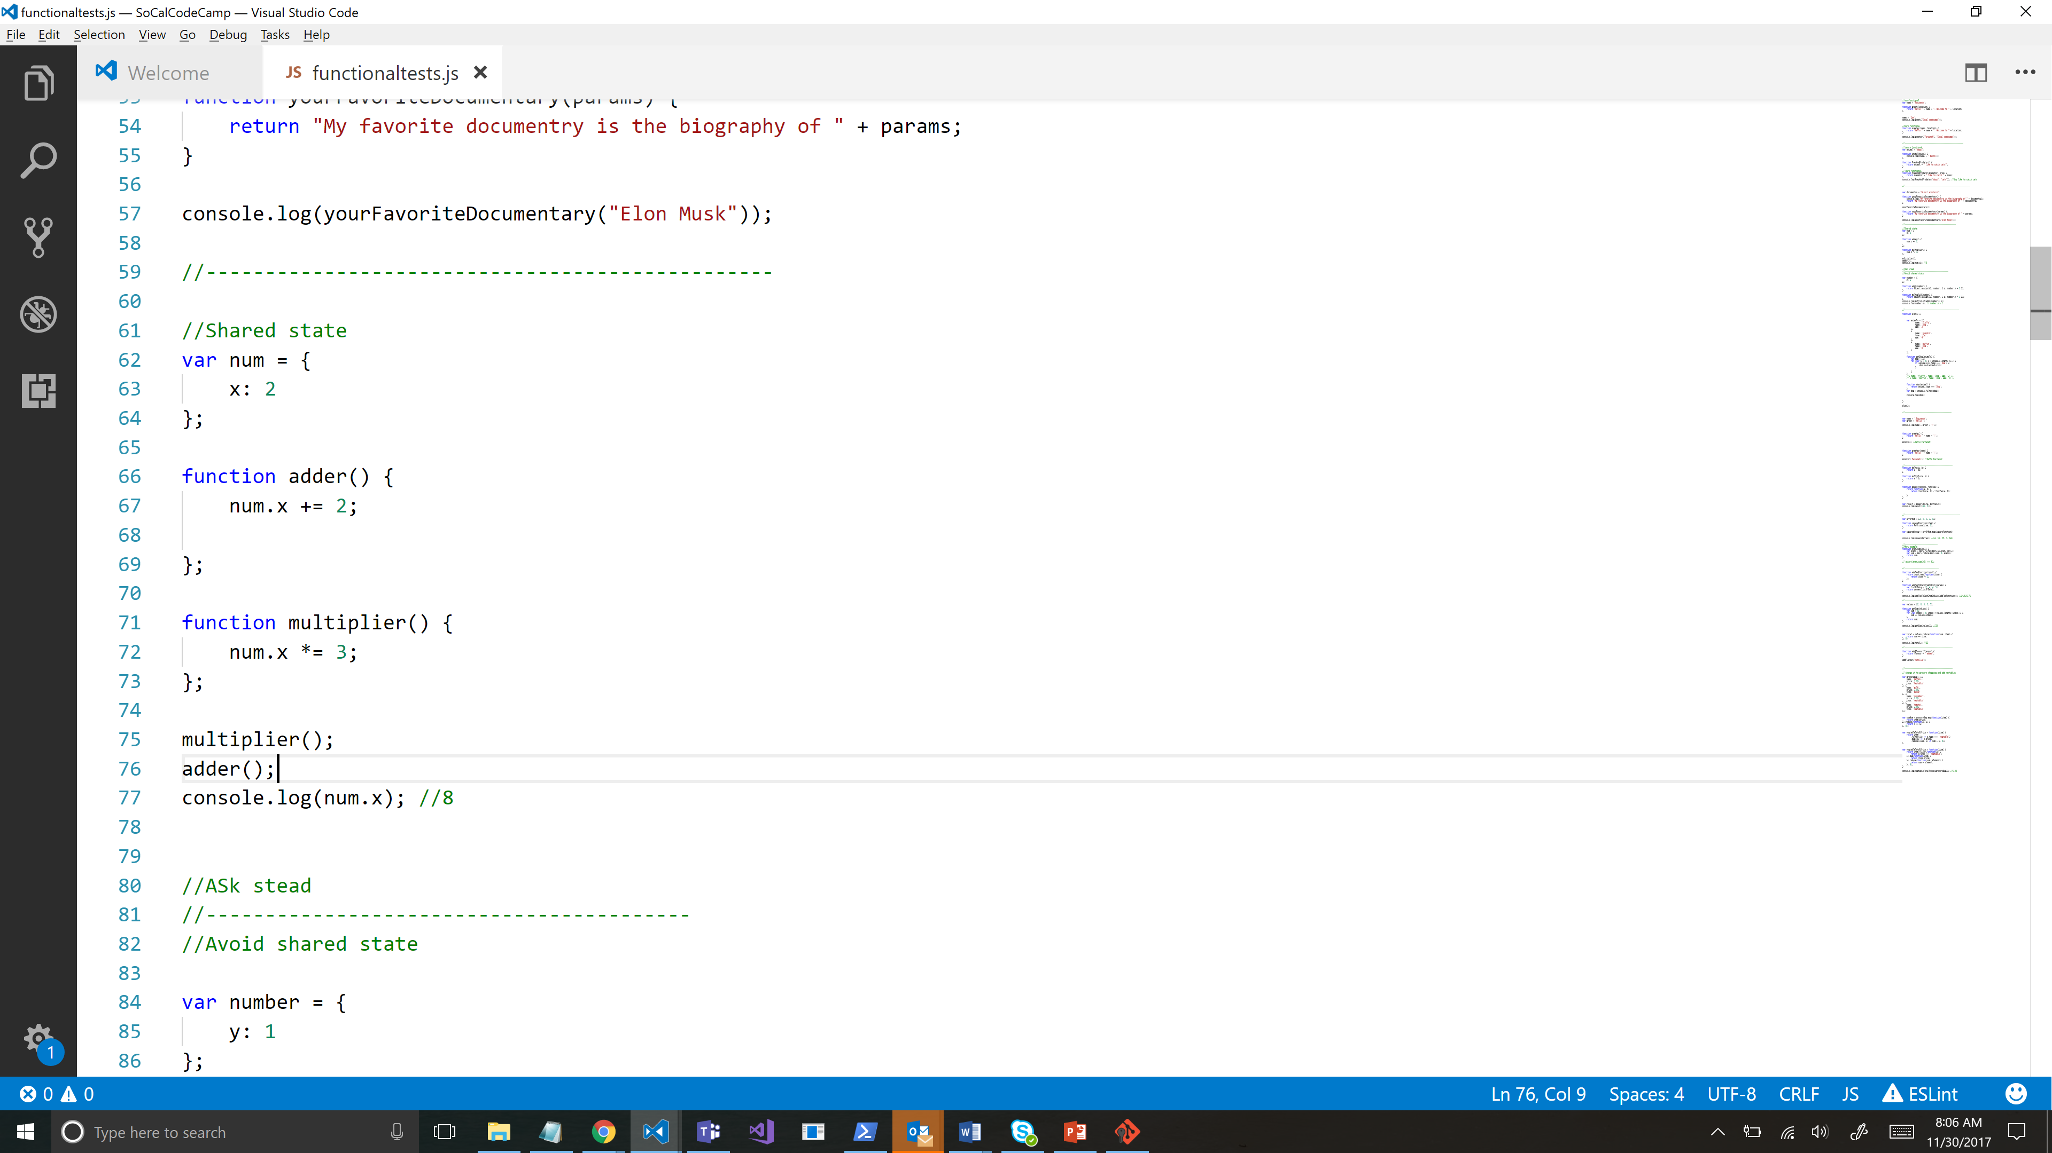
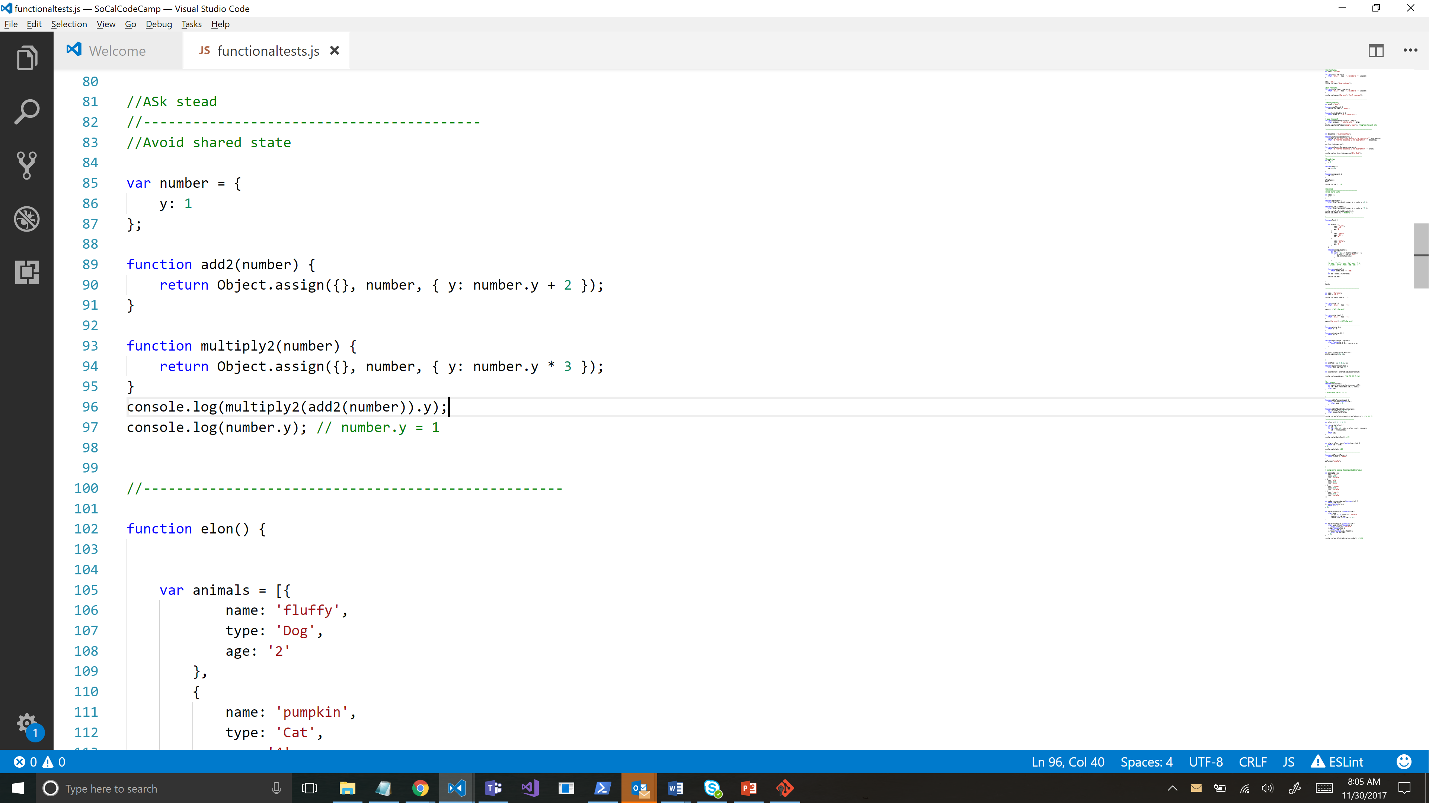
Pure functional- Avoid sharing state

Slide 19
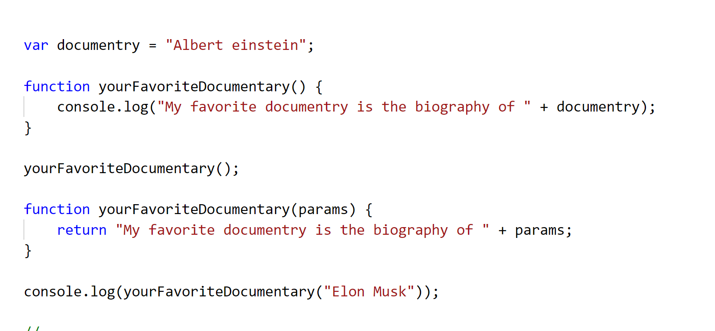
Pure functional- Avoid side effect

Slide 20
Functional Programming Techniques
Higher order function
Function composition
Functions re-usability
Function currying

Slide 21
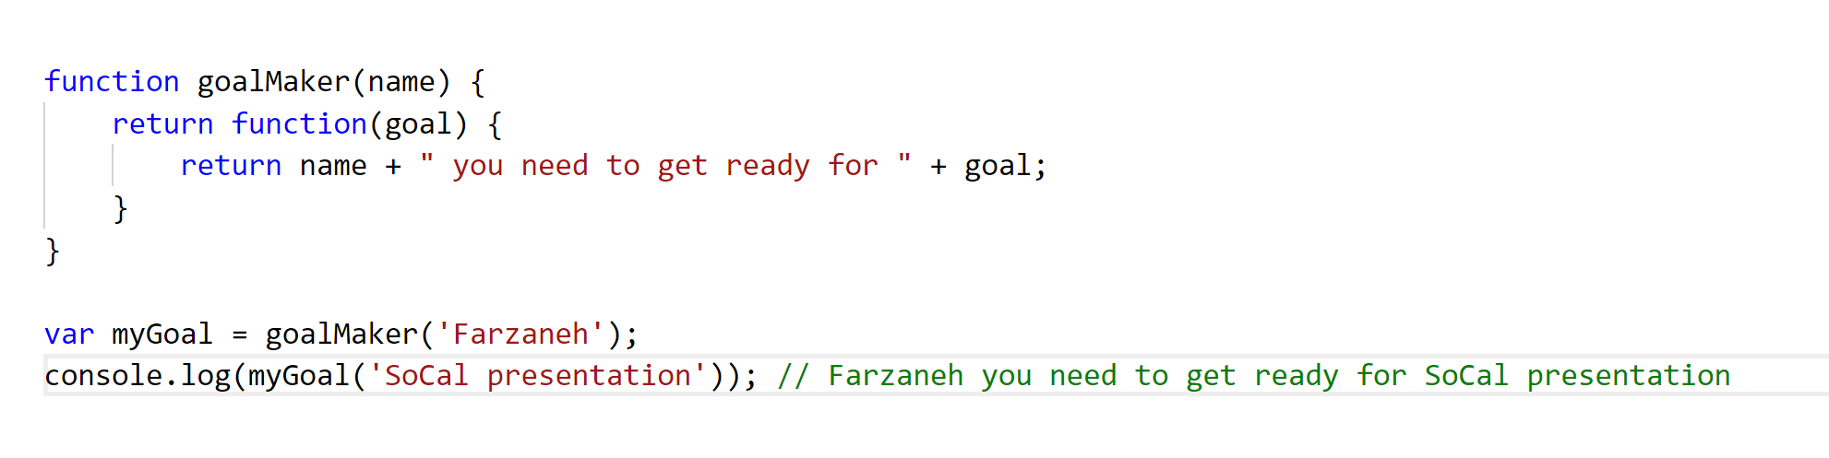
Functional Programming Techniques
Higher order functions
Pass functions as arguments or return functions

Slide 22
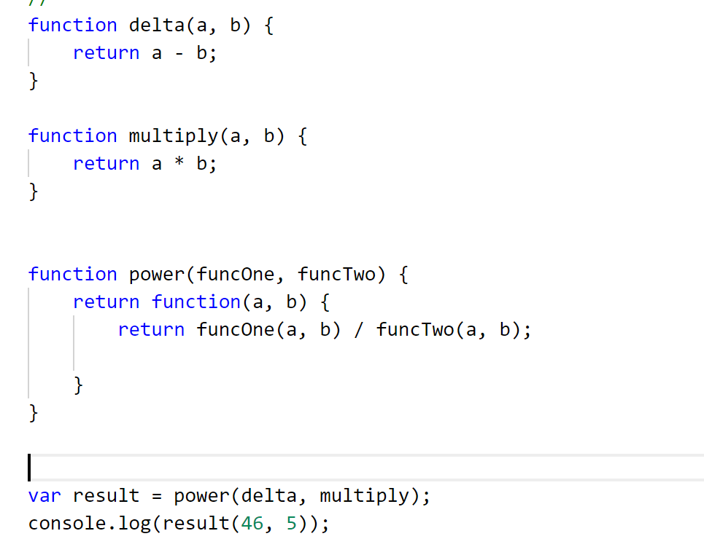
Higher Order Functions

Slide 23
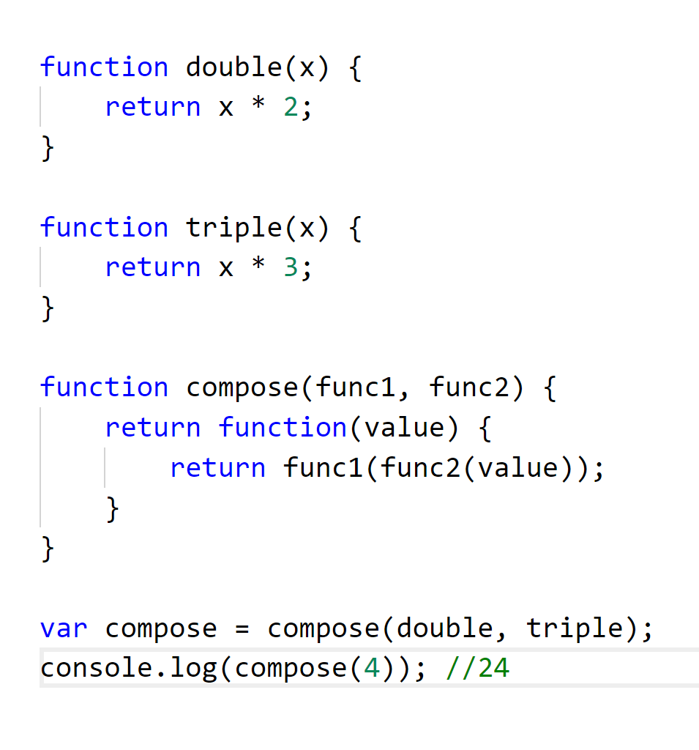
Function composition

Slide 24
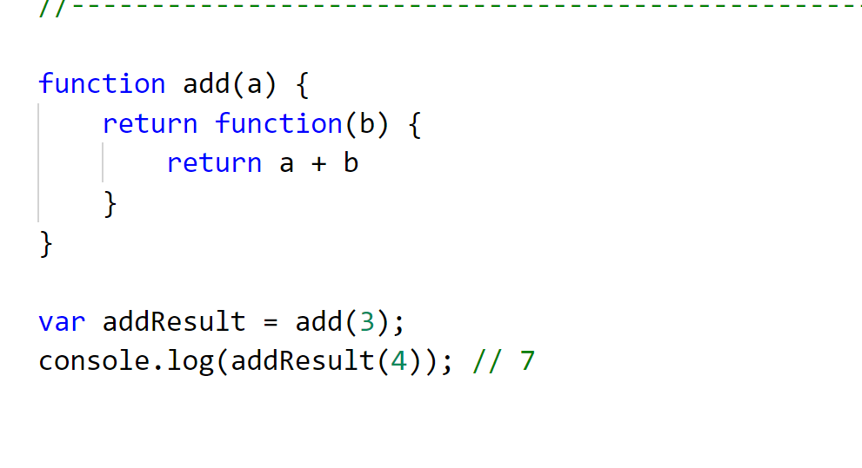
Function Currying

Slide 25
Higher order functions
Map
Filter
Reduce

Slide 26
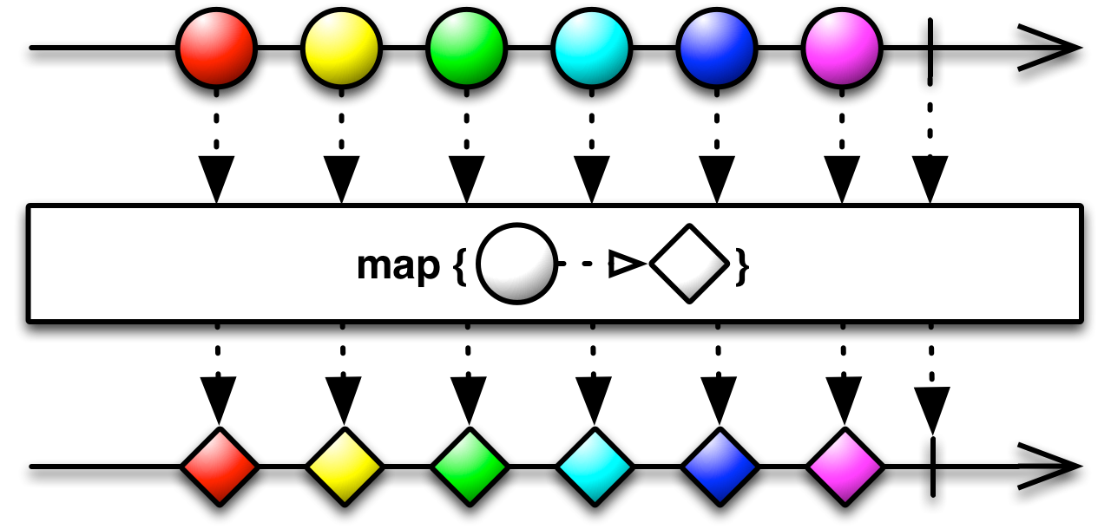
Map
Avoid data mutation

Slide 27
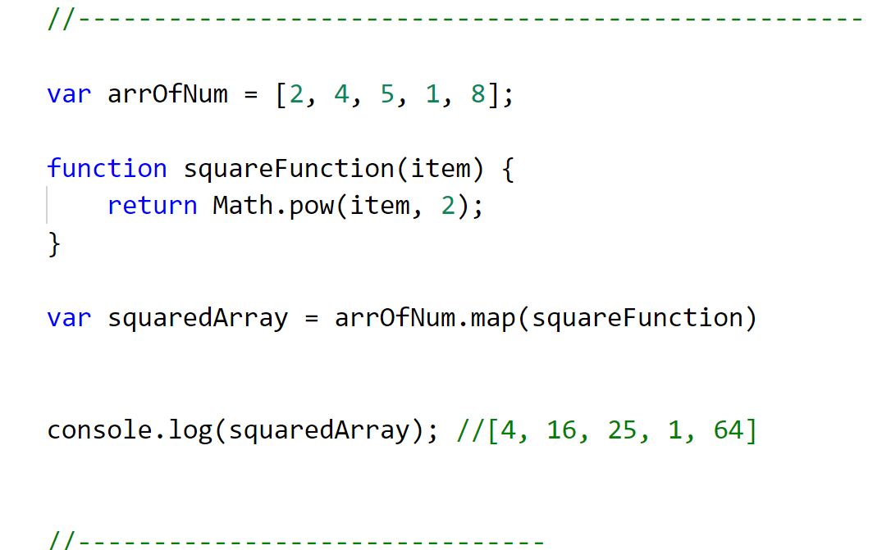
Map example

Slide 28
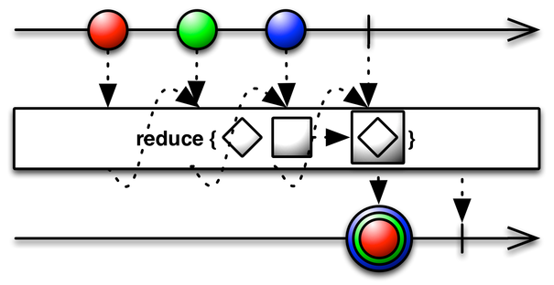
Reduce
Higher order function
Works on variety of datatype

Slide 29
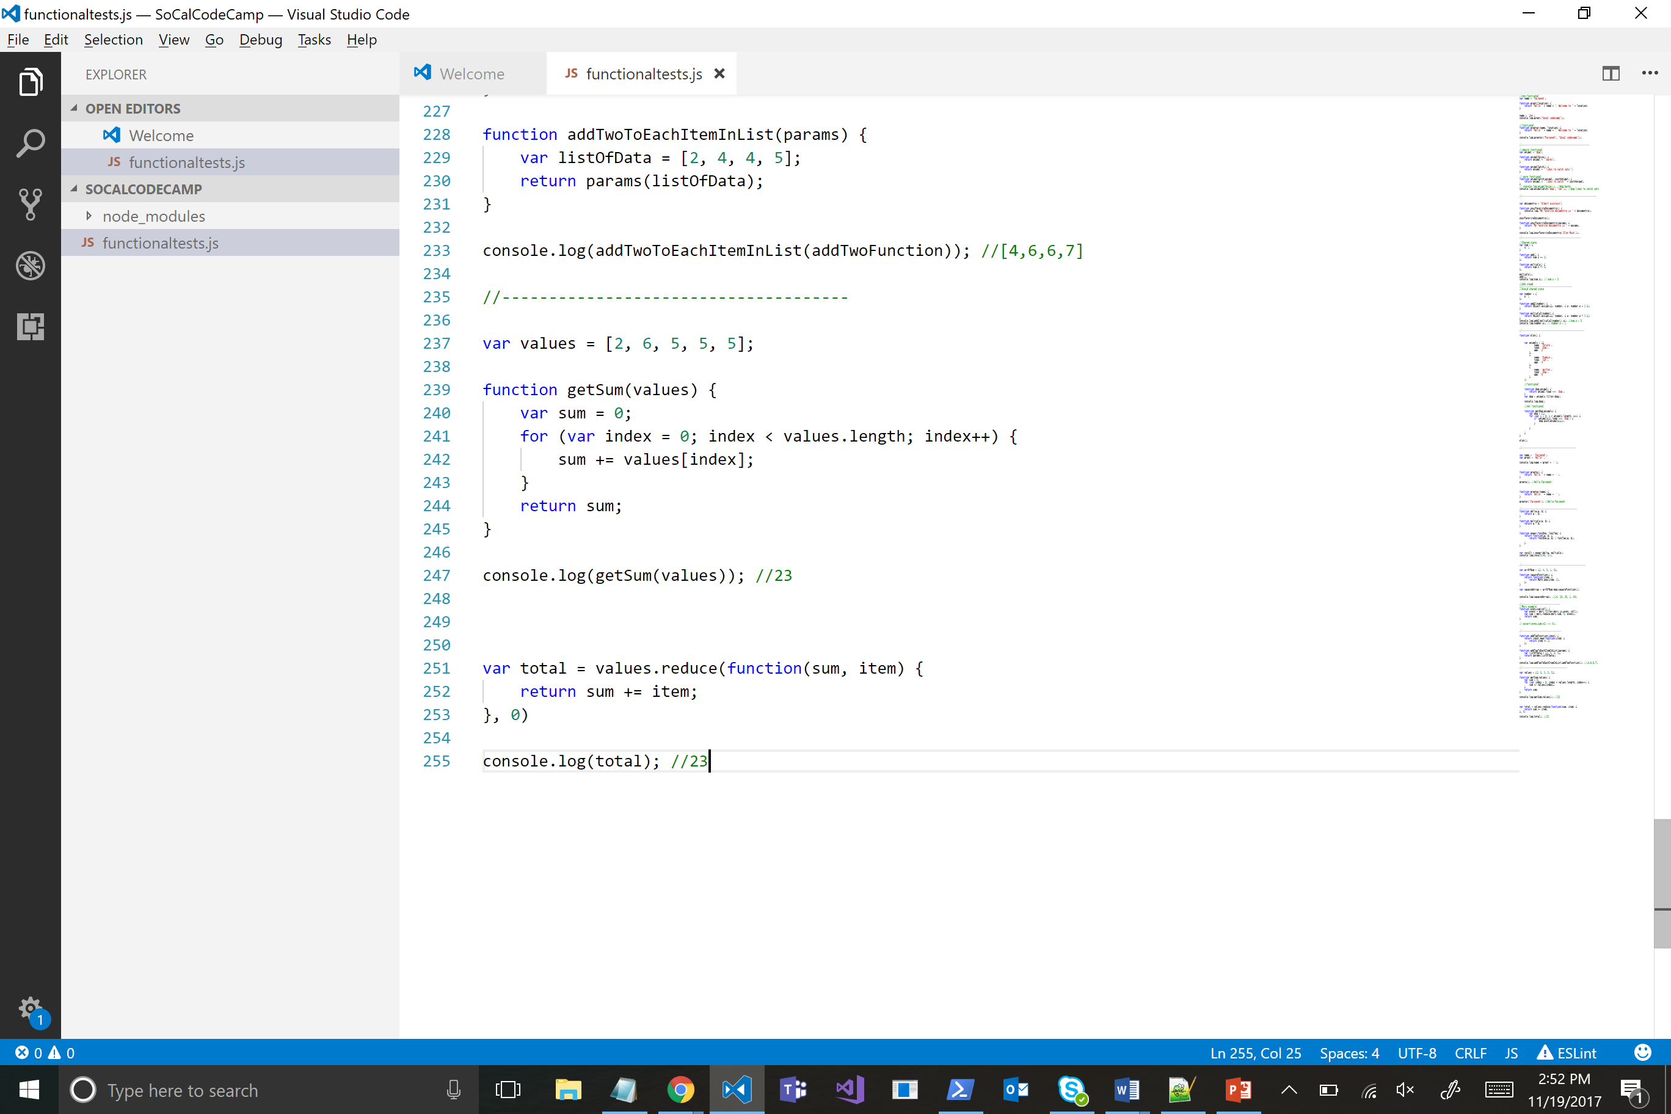

Reduce

Slide 30
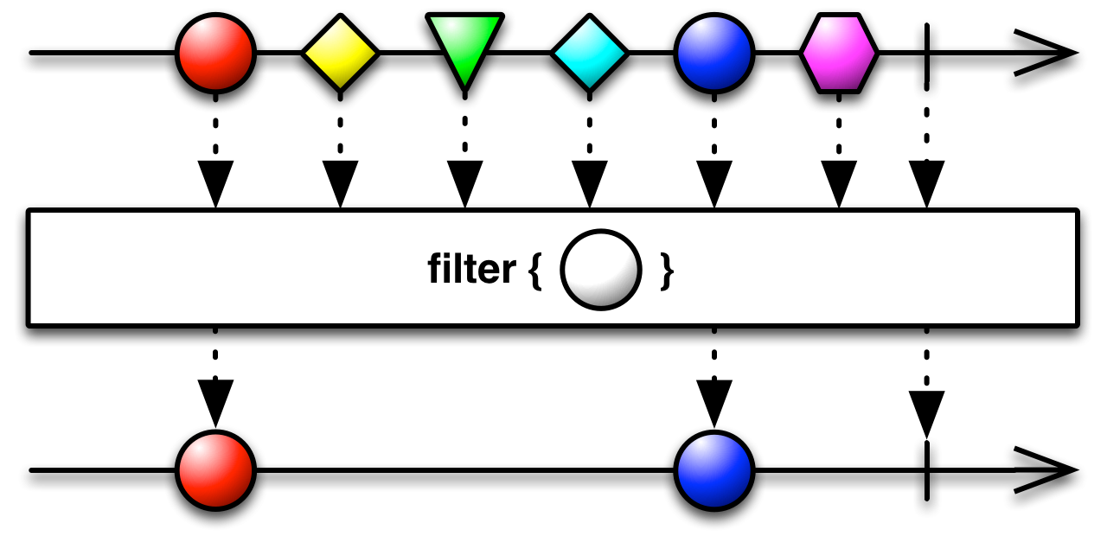
Filter
Avoid data mutation

Slide 31
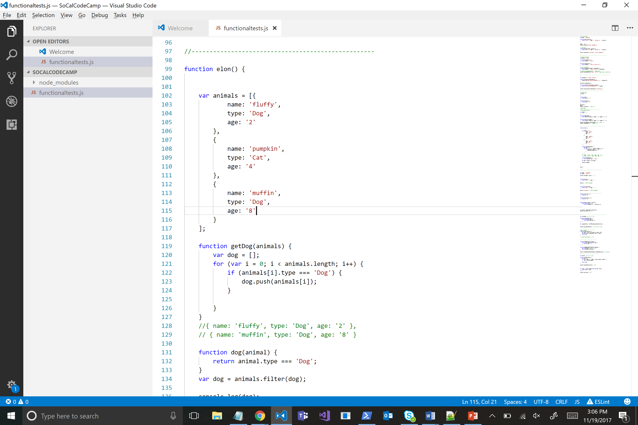
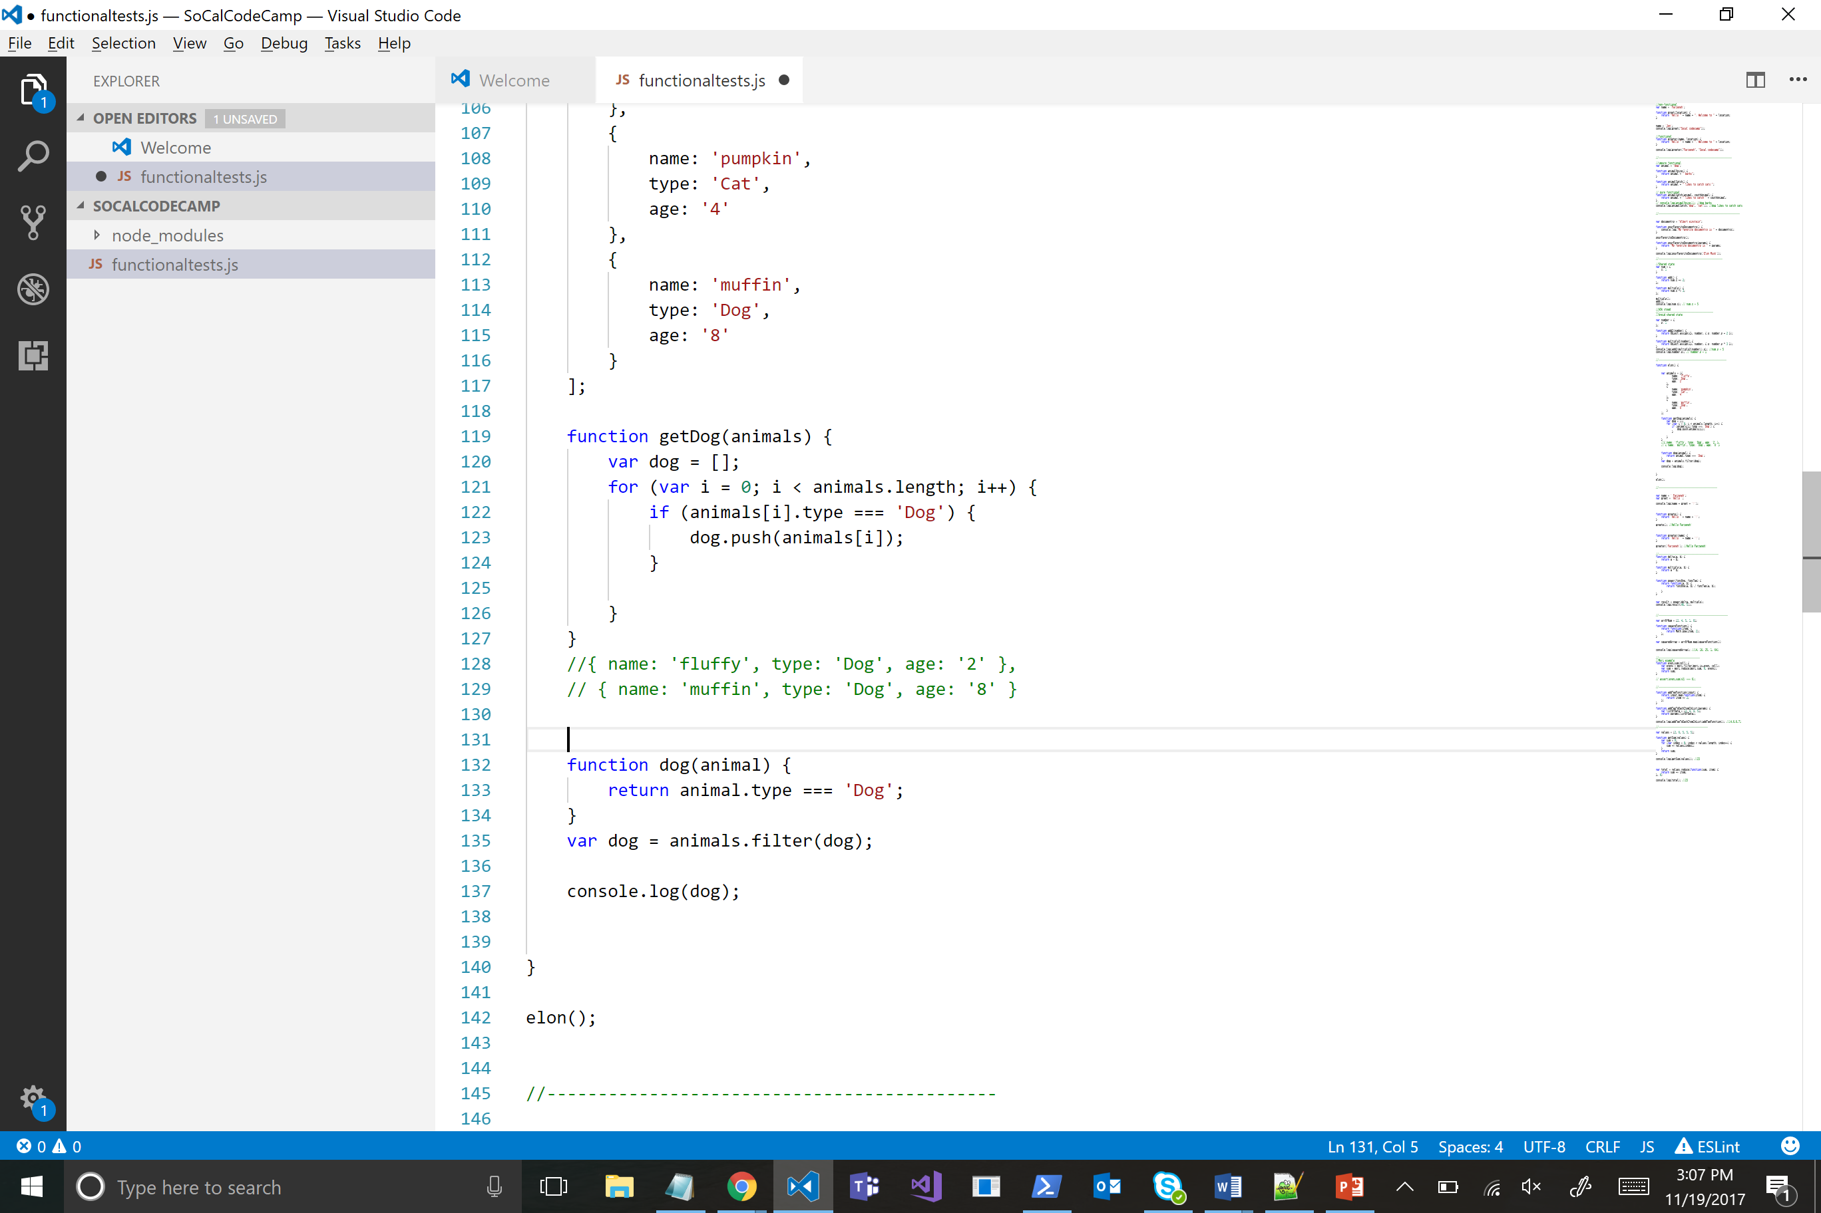
Higher order function-Filter

Slide 32
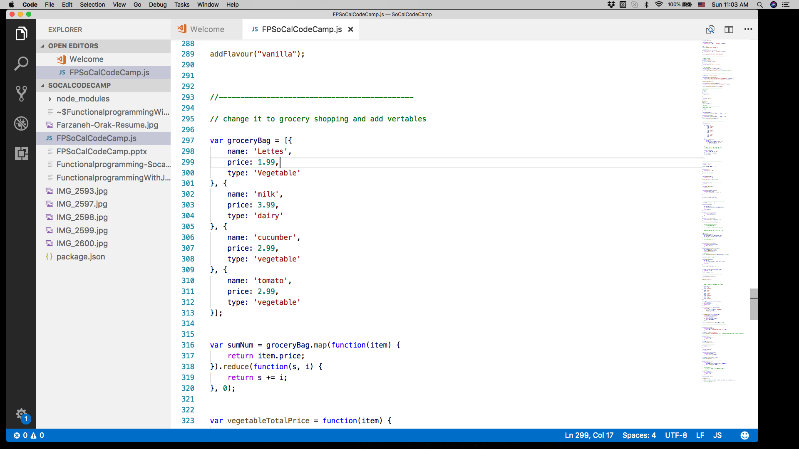
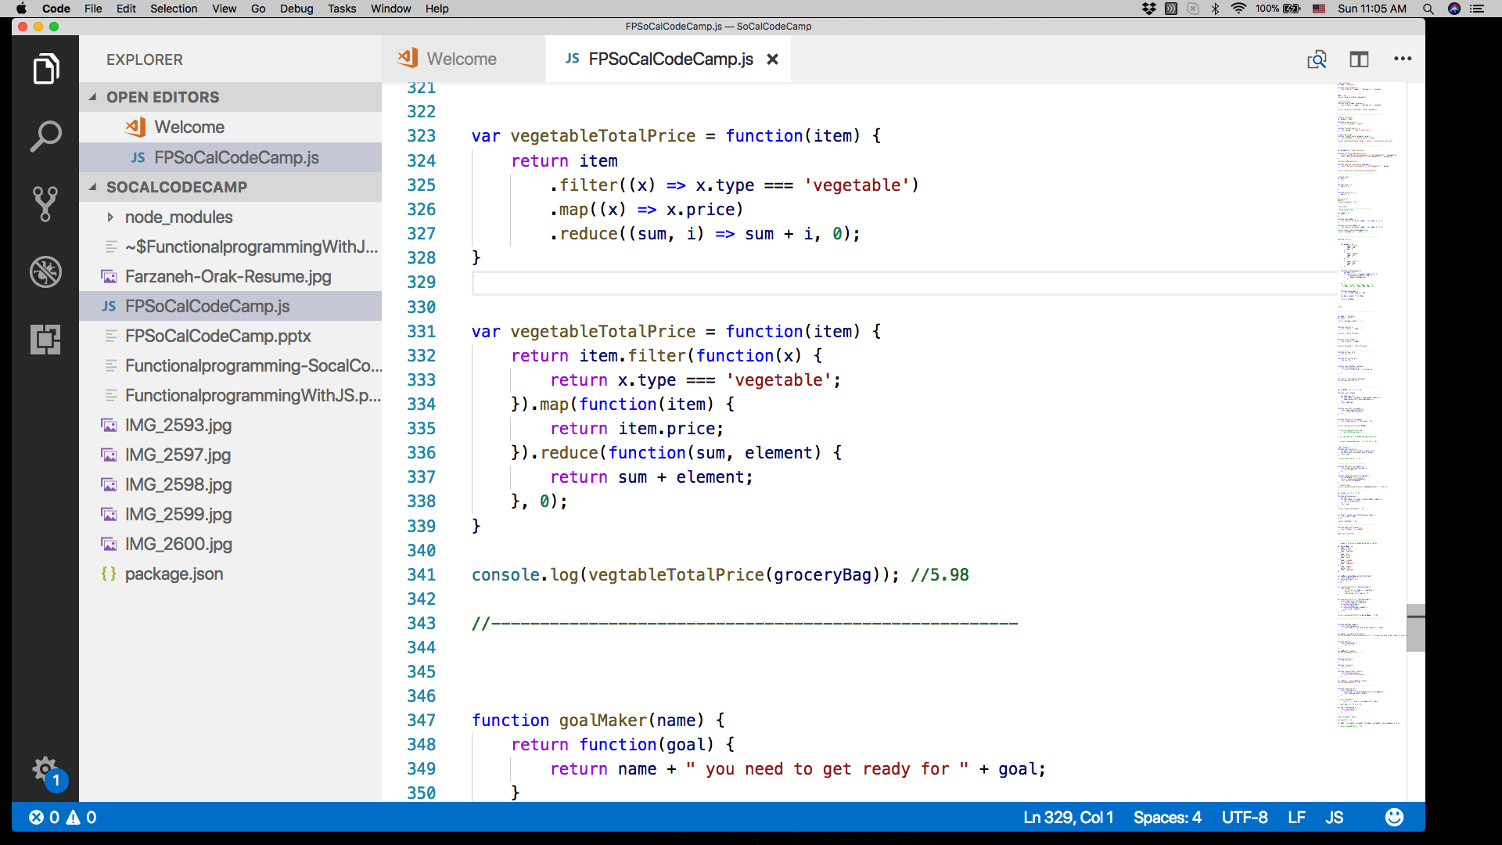
Higher order function-composition

Slide 33
Function composition

Slide 34
Trie data structure
Trie data structure
Structural sharing

Slide 35
Trie data structure
2
4
6
2
4
6
5

Slide 36
Libraries
JFP
Ramda
Lodashfp
Mori
Immutable js

Slide 37
Recap
Functional Programming Principles
Avoid shared state
Avoid side affect
Avoid data mutation
Functional Programming Techniques
Pure function
Higher order functions

Slide 38


Thank you!
Farzaneh Orak
linkedin.com/in/farzanehorak
@FarzanehOrak

